Slide 1

Paper Presentation on
Deep learning based multimodal emotion recognition using model-level fusion of audio–visual modalities
Group #13
Presented by
Md. Reasad Zaman Chowdhury 23166016
ST/RA
Abid Hossain and MD Humaion Kabir Mehedi

Slide 2
Introduction
The emotional states of individuals have a significant impact on human communication
Recognizing emotional states has numerous practical applications including audio–visual surveillance, affective computing, online teaching–learning, human–computer interaction (HCI)
It is also important for machines to be able to recognize human emotions
The paper proposed a novel multimodal emotion recognition model by fusing audio and video features at the model level

Slide 3
Motivation
Human emotion recognition can be accomplished through a variety of means such as speech data, facial expressions and gestures
Previous researches show that relying solely on a single modality for is inefficient
Fusioning multiple modalities (audio, video, text, etc.) can be quite effective in emotion recognition
This paper tried to explore the multimodal analysis of human emotions using video and audio data

Slide 4
Dataset
RAVDESS
SAVEE
Contains 7356 files of speech from 24 professional actors
The dataset contains video-only (no sound), audio-video, and audio-only modalities of data
The speech exhibits seven emotions, namely disgust, surprise, fearful, sad, happy, angry, and calm
Dataset contains 480 British English utterances spoken by four male actors
The dataset contains audio-only modality of data
Data express seven emotions (anger, disgust, fear, happiness, sadness, surprise, and neutral)

Slide 5
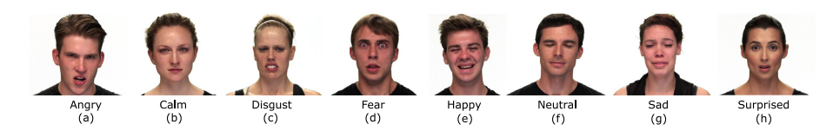
Data Preprocessing
Total 6 frames/video is extracted for every sample
To capture the spatio-temporal information associated with a particular emotion

Slide 6
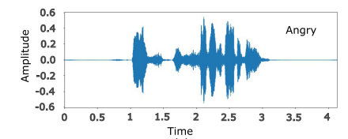
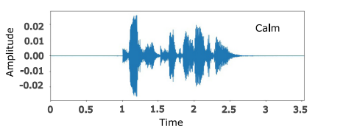
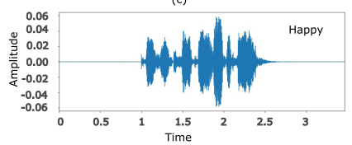
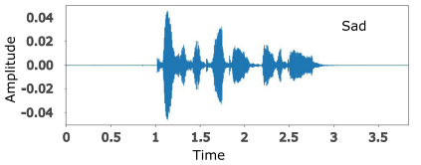
Data Preprocessing

Slide 7
Proposed Model
Several networks based on Convolutional Neural Networks have been performed to identify the most effective of feature extractors
Different variants of audio and video feature extractor networks are explored, varying in the number of layers
A 2-dimensional CNN is employed as the video feature extractor
The audio feature extractor is a 1-dimensional CNN
The flattened outputs from the video and audio feature extractors are then concatenated to create a single feature vector

Slide 8
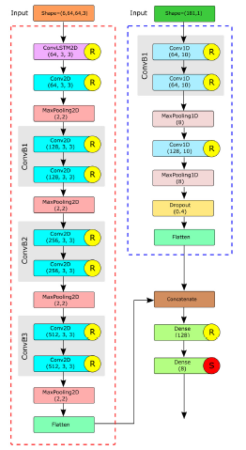
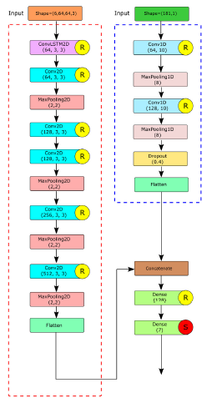




RAVDESS
SAVEE

Slide 9
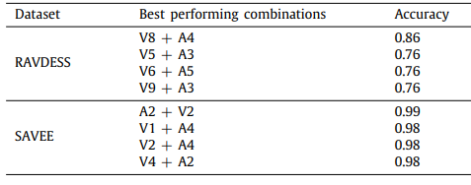
Experimental Result

Slide 10
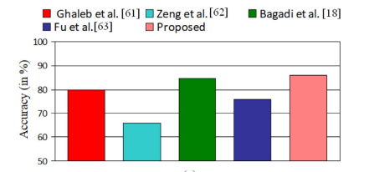
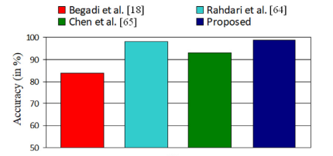
Comparison with Previous Works
RAVDESS
SAVEE

Slide 11
Limitations & Future Scope
This work explored model-based fusion approach of audio–visual modalities for classifying human emotions
Two different multimodal models achieve the best results on different dataset
A universal optimal model for multimodal emotion recognition is still remains the subject of intensive research
More auditory features can be utilized
More modality such as text data can be explored along with audio-visual data

Slide 12
References
[1] Middya, A. I., Nag, B., & Roy, S. (2022). Deep learning based multimodal emotion recognition using model-level fusion of audio–visual modalities. Knowledge-Based Systems, 244, 108580.

Slide 13
Thanks!

